Slide 1
IoT Home Automation System
ISE222-Group 27
Abhishek Balaji Rao
Geethan Rajkumar
Shuchi Shaileshkumar Patel
Swayam Jaiminkumar Shah

Slide 2
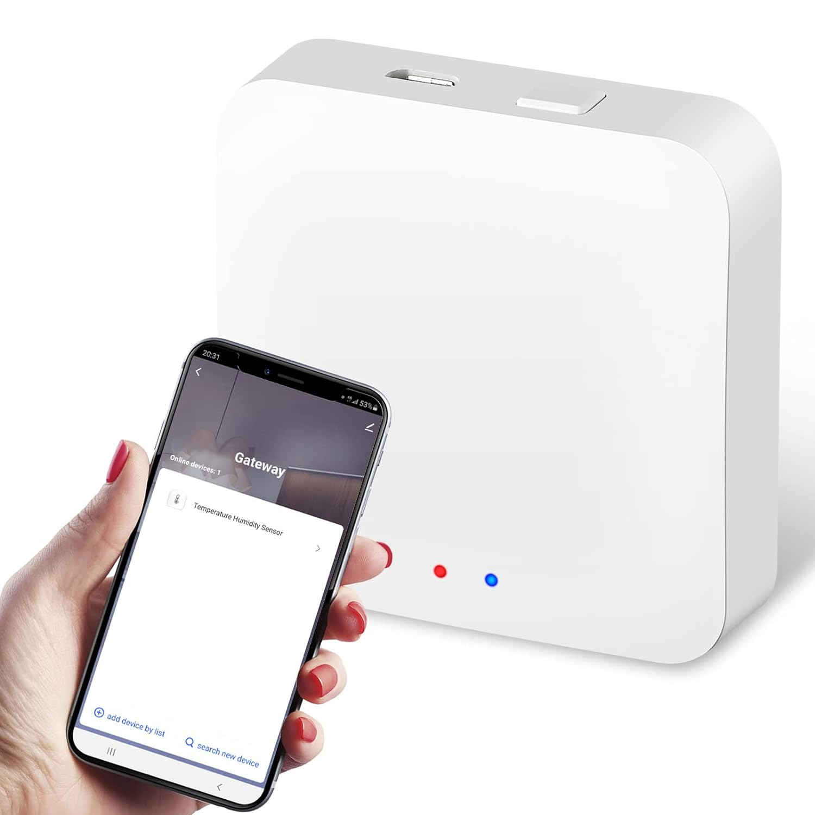
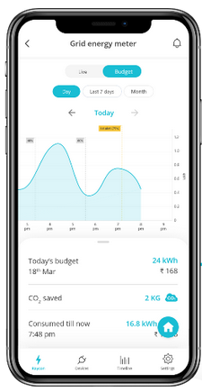
Problem Identification
Problem: Not many devices on the market can seamlessly integrate different devices and control all aspects of a smart home.
Estimated to be more than 43 billion devices connected to the internet in 2023 according to Forbes.
Our suggested hub/gateway device and companion app seek to provide a comprehensive, user-centric solution that meets the changing requirements of the smart home industry.

Slide 3
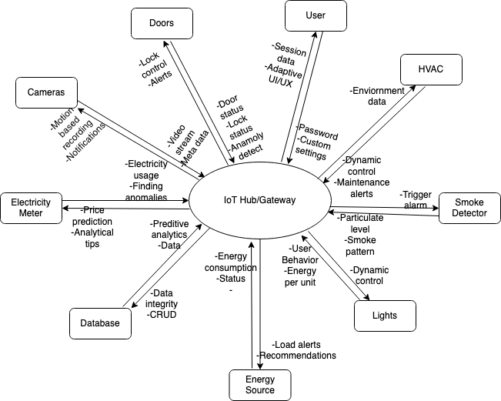
Context Diagram

Slide 4
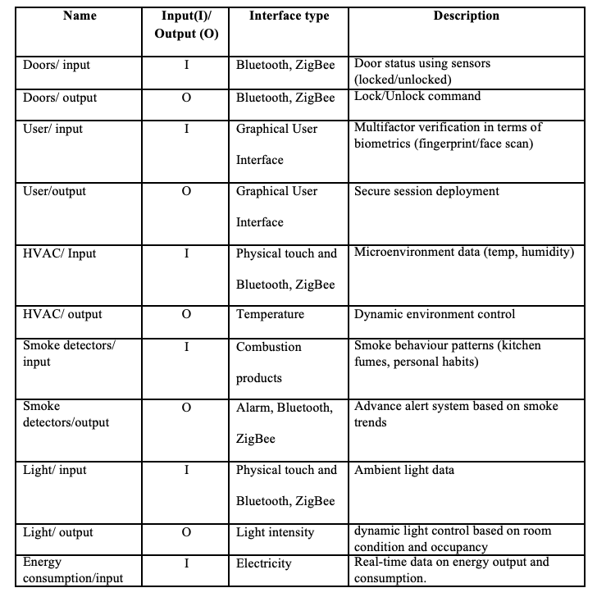
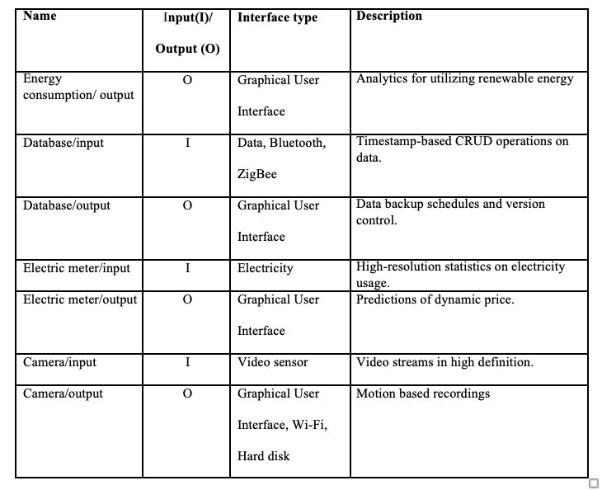
Interfaces

Slide 5
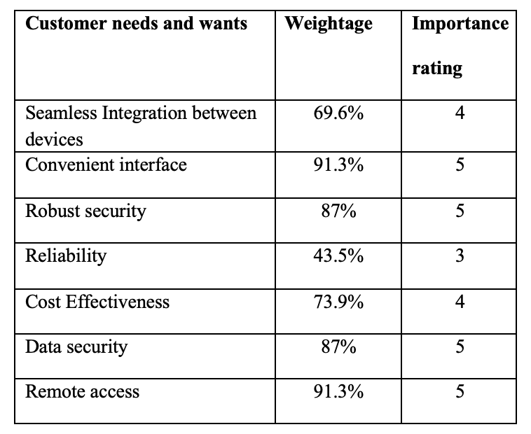
Customer Requirements
Based on the survey results, the Importance ratings were assigned to different customer needs and wants.

Slide 6
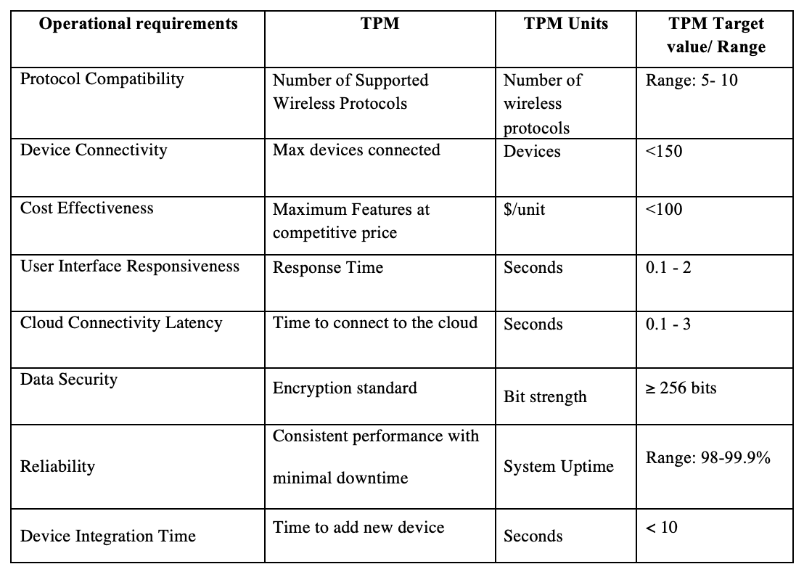
Operational Requirements & TPMs

Slide 7
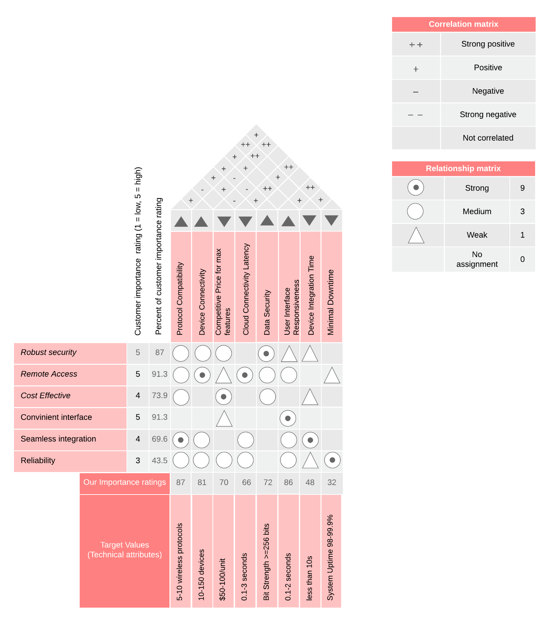
HOQ

Slide 8
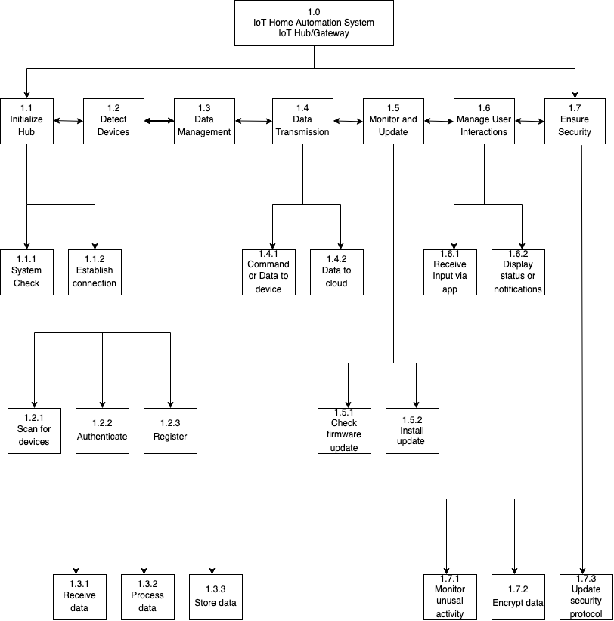
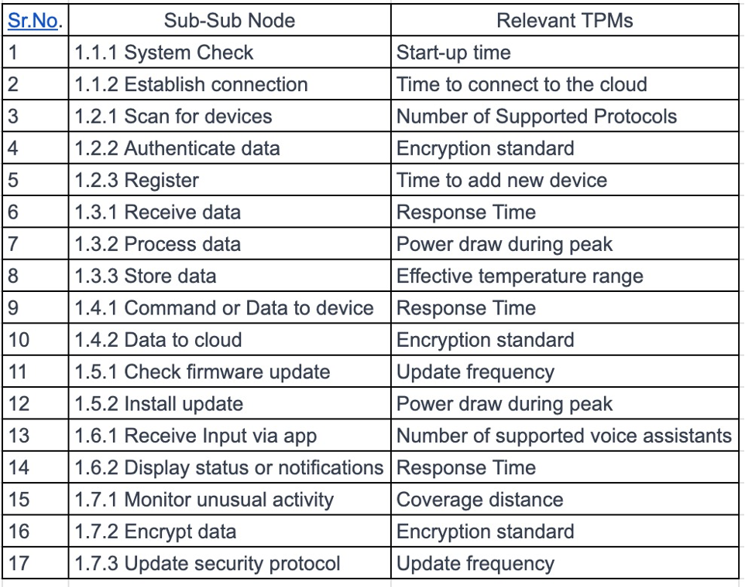
Functional Analysis
and Requirement Allocation

Slide 9
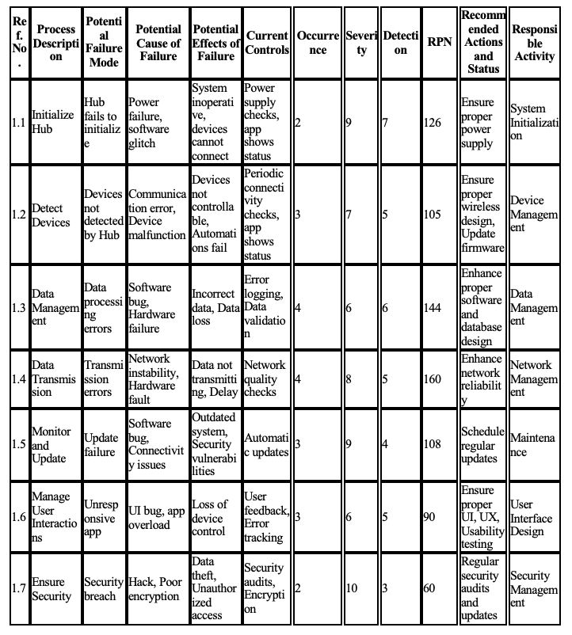
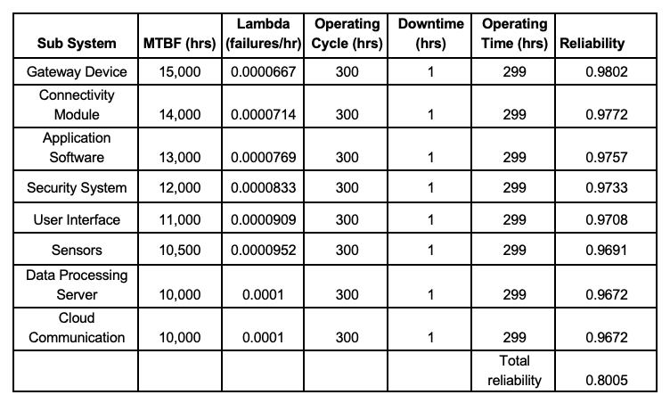
Measures of Effectiveness: Reliability - FMECA

Slide 10
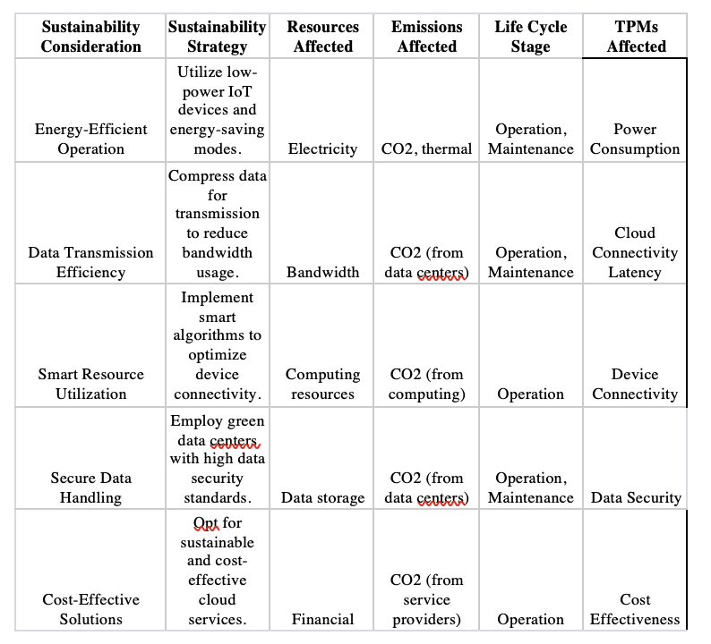
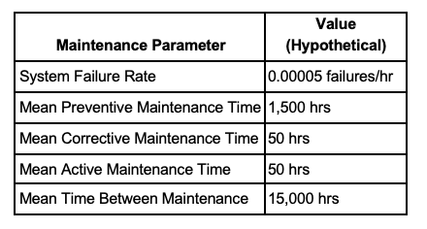
Measures of Effectiveness: Sustainability and Maintainability

Slide 11
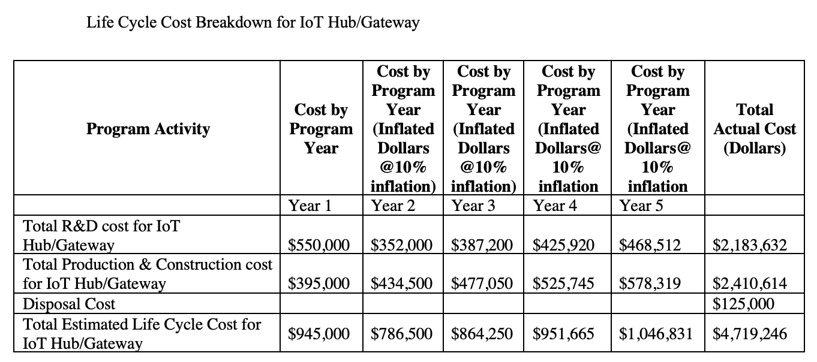
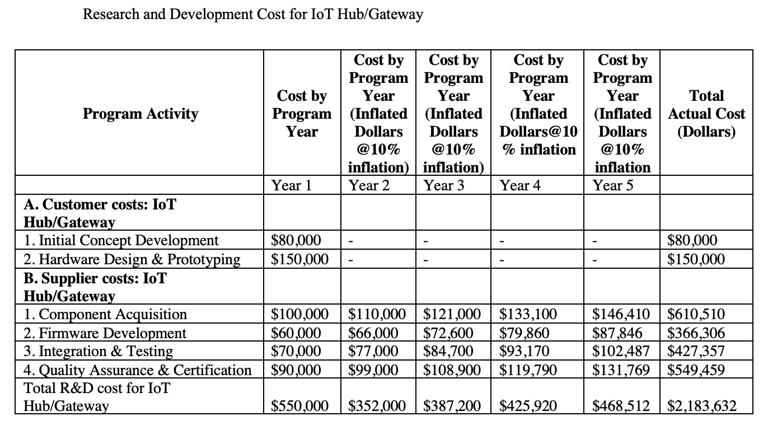
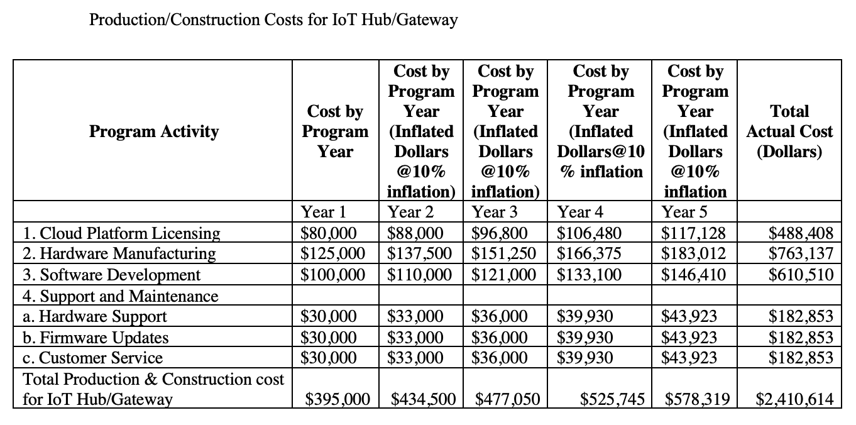
Life Cycle Costing

Slide 12
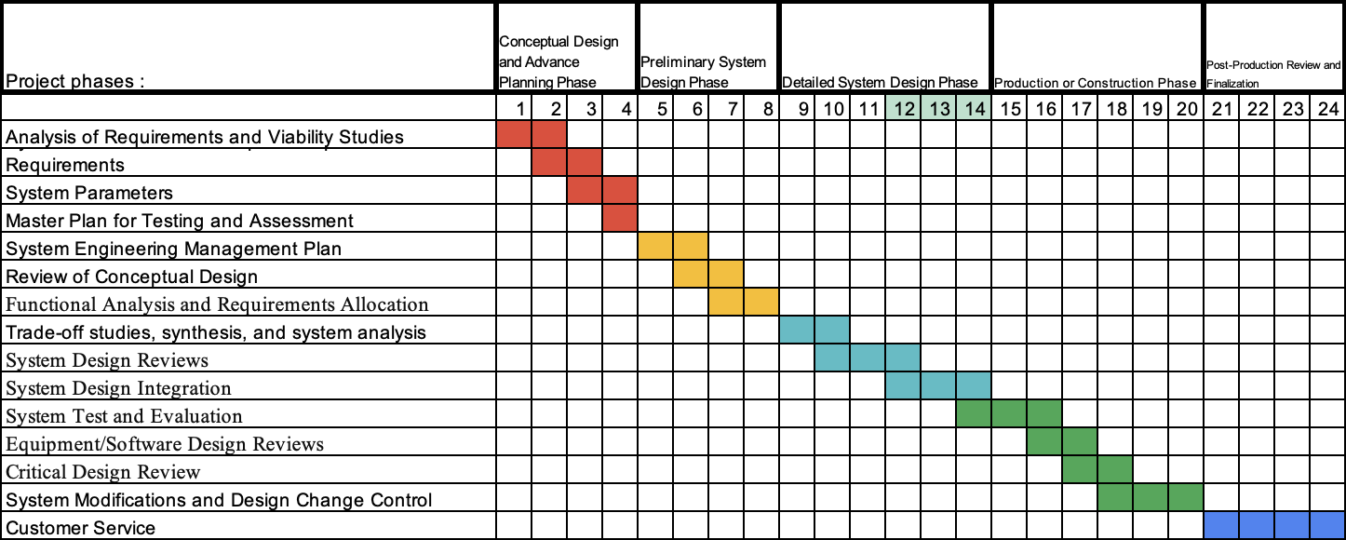
Systems Engineering Management Plan (SEMP)

Slide 13
Thank you

